Slide 1
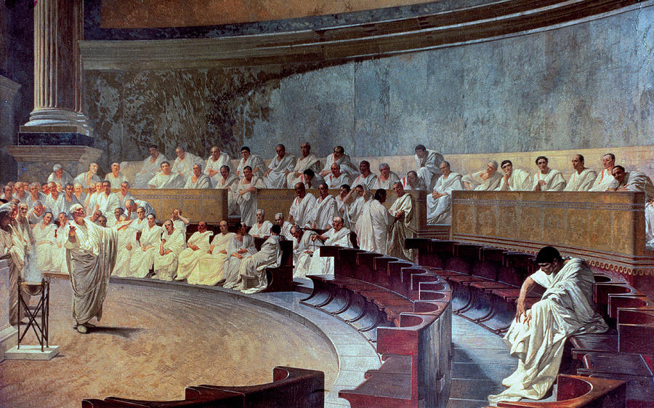

Slide 2
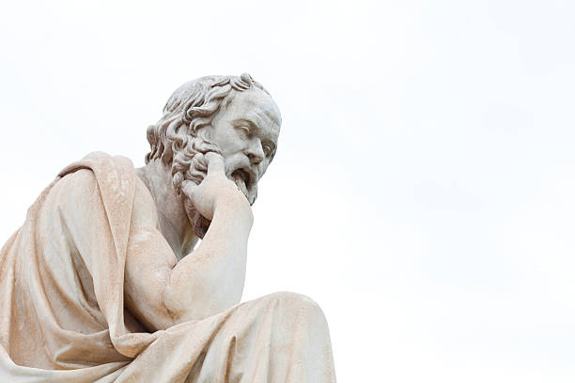
For centuries, political historians have theorized about the origin of the state and government
Four theories have become the most commonly accepted explanations of how government began

Slide 3
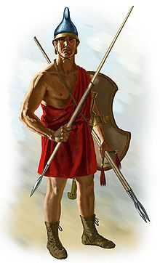
Government (the state) was created by force
One person or group claimed control over land
The people were forced to submit to the rule of this person/group

Slide 4
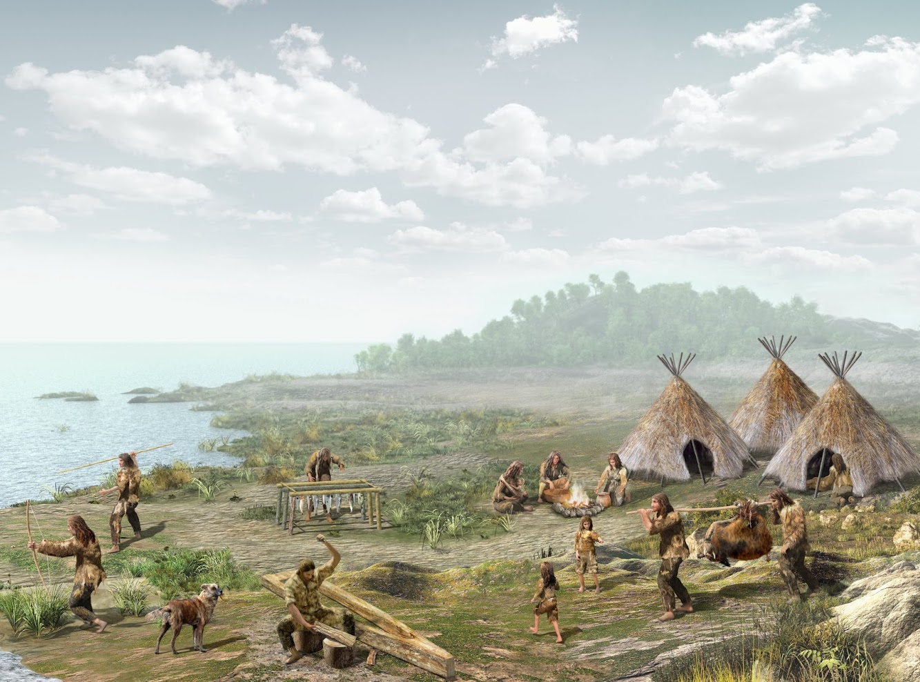
A primitive family where one person was the head is the root of early government
Over time, this family evolved into a clan & then a tribe
When farming began, the tribe settled down & government began

Slide 5
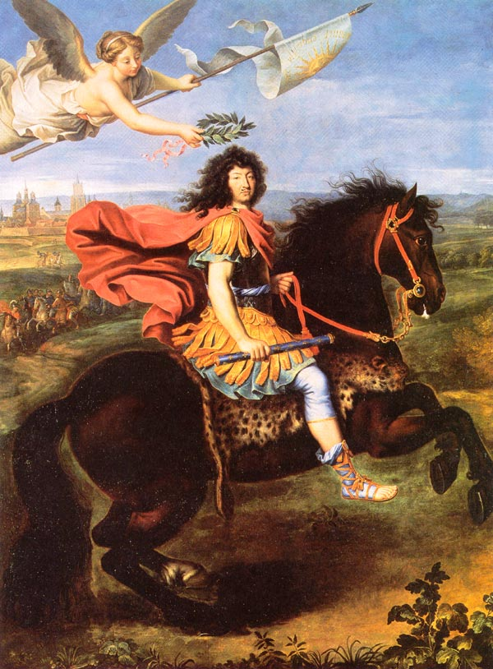
God created the state and gave those of royal birth “divine right” to rule
The people were bound to obey the ruler as they would God

Slide 6
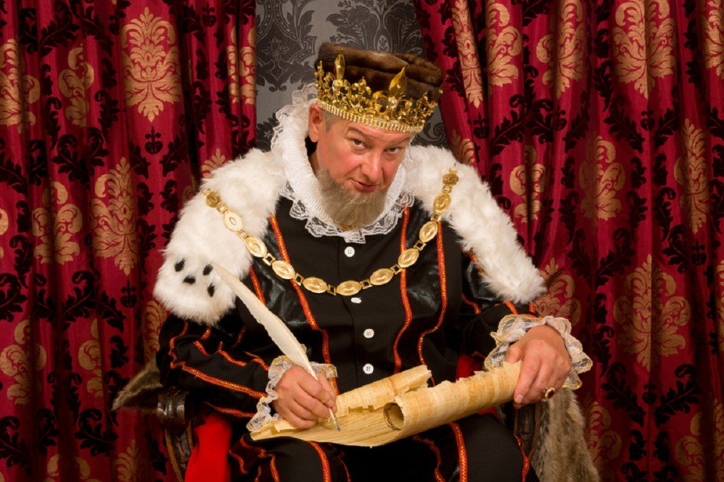
Before government, the strong took what they wanted & no authority existed to stop them
Humans created govt because they were tired of this “unpleasant condition” & agreed to give up power to the government in exchange for safety

Slide 7
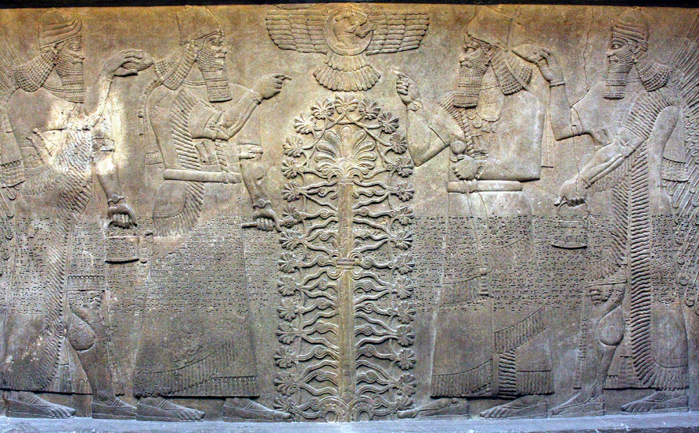
Which theory do you think is most likely how government began? Explain your reasoning in 15 words or less.

